Slide 1
Videography for Consumer Research: Past, Present and Future
Presenter:
Dr. Eric Ping Hung Li, Associate Professor and Principal’s Research Chair (Tier 2) in Social Innovation for Health Equity and Food Security, Faculty of Management, University of British Columbia – Okanagan
IQRN Webinar Series
July 12, 2023

Slide 2


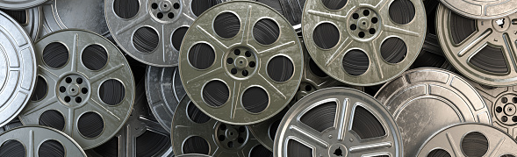
agenda
Welcome and Introduction
Background of Videographic Consumer Research
Types of Videography
Creating Videographic Consumer Research
Judging and Evaluating Videographic Productions
Other Considerations: Ethics (consent) and Copyright
Q&A
International Qualitative Research Toolkit

Slide 3
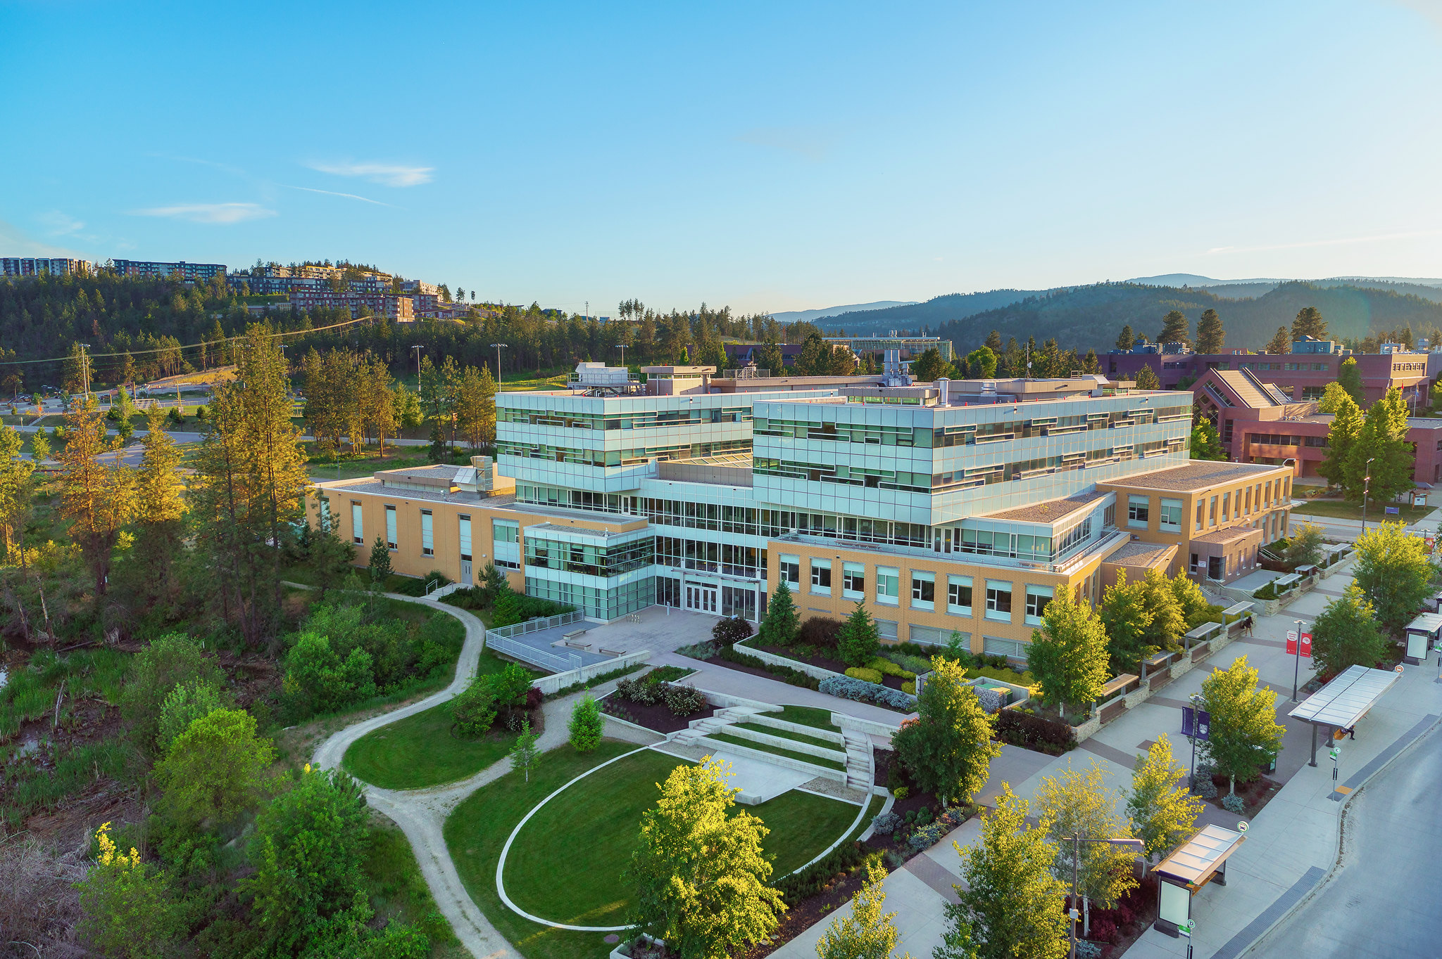
Land acknowledgement
I would like to begin by acknowledging that the land on which UBC-Okanagan located is the unceded territory of the Syilx (Okanagan) Peoples.

Slide 4

Who Am I?
Dr. Eric Li
Associate Professor and Principal’s Research Chair (Tier 2) in Social Innovation, University of British Columbia – Okanagan campus
Co-Chair of Association for Consumer Research Film Festival, 2020, 2021, 2022, 2023
Research Interests: Community development, social innovation and social entrepreneurship, global consumer culture, health equity, qualitative and mixed-methods studies
Previous Videography Projects:
Walczak, W., Li, E. P. H., Nelson, S. and Muscardin A. (2021). Time Compression: A Rhythmanalysis of a Consumer’s Everyday Life.
Li, E. P. H. and Belk, R. W. (2010). Remade China: The Re-Production of Chineseness in a Multi-Cultural Society.
Li, E., Belk, R., and Joy, A. (2008). Disney Dreams in China.
Belk, R. W., Seo, J. Y., and Li, E. P. H. (2006). Dirty Little Secret: Home Chaos and Professional Organizers.
Email: eric.li@ubc.ca
Notes:
I feel many will want to continue the conversation.

Slide 5
Background of videographic consumer research
Videographic consumer research philosophically anchored by the traditions of visual anthropology, sociology, arts, and aesthetics as well as visual culture. It represents a different perspective on phenomena from that traditionally associated with marketing or business (Belk et al., 2018, p. 432).
Videography is a technical consumer research tool (Hietanen, Rokka, and Schouten, 2014) adopted by consumer researchers to represent and theorize phenomena in social, cultural, and spatio-temporal contexts; a way of isolating different dialogue, place, and time (see also Cubitt, 1991; Belk et al., 2018).
Videography can inform our theorizing as “video becomes an agent in the process by which knowledge is produced” (Pink, 2004, p. 64)

Slide 6

Types of videography
Ethnographic Films
Documentary Films
Experimental Films
A practice of visual anthropology informed by the theories, methods, and vocabulary of the discipline of anthropology, involving the use of the camera/camcorder as a research tool in documenting whole, or definable parts of, cultures with methodological awareness and precision (Kuhn & Westwell, 2012).
A documentary film deals with actual and factual (and usually contemporary) issues, institutions, and people; whose purpose is to educate, inform, communicate, persuade, raise consciousness or satisfy curiosity about the world outside the film (Bordwell & Thompson, 2001). It is a nonfiction film about real events and people, often avoiding traditional narrative structures (Corrigan, 2001). It is also considered the creative treatment of actuality (Grierson, 1933).
Experimental film is a mode of filmmaking that rigorously re-evaluates cinematic conventions and explores non-narrative forms or alternatives to traditional narratives or methods of working (Pramaggiore & Wallis, 2005).

Slide 7
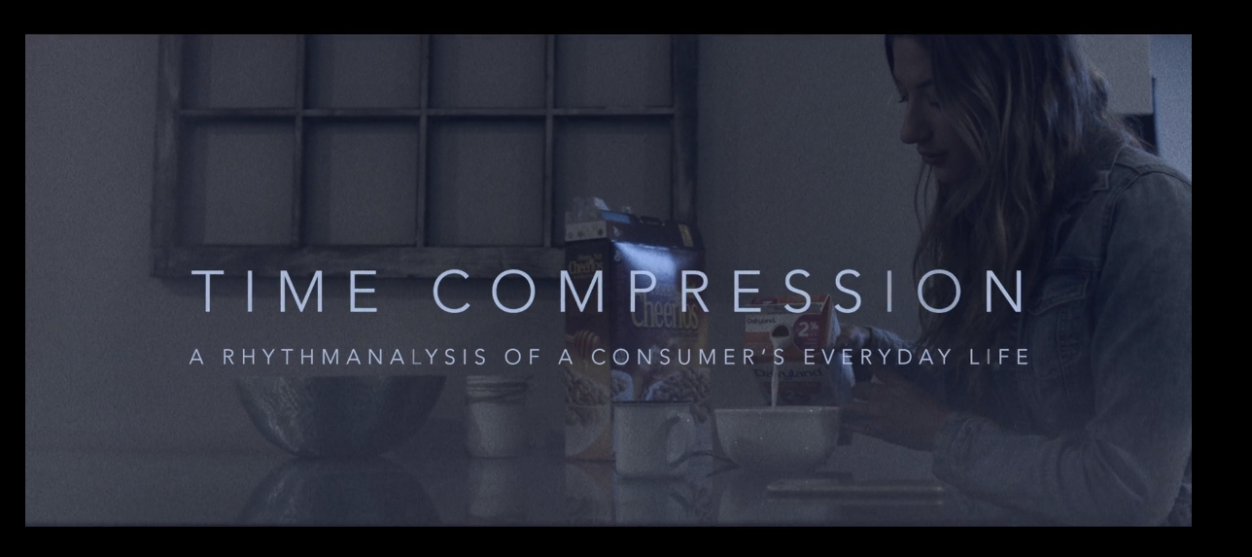
Sample film - Time Compression: A Rhythmanalysis of a Consumer’s Everyday Life
Time Compression: A Rhythmanalysis of a Consumer’s Everyday Life
Full video link: https://vimeo.com/543868367 (13:10)
Trailer: https://vimeo.com/586048924 (00:29)
Filmmakers: William Walczak, Seger Nelson, and Eric Li
University of British Columbia – Okanagan, Canada

Slide 8
Creating videographic consumer research
Step 1:
Videography is all about discovery – choose an interesting phenomenon, theory, concept, interaction, or else.
Tips: Have an open mind!
Step 2:
Create a road map (or a script):
Identify the phenomenon (or story),
Research the consumer story,
Choose a research methodology,
Prepare the blueprint and the script of the story,
Present your viewpoints (or let the audience decide),
Refine the story and present the contributions of your videography.

Slide 9
Creating videographic consumer research
Step 3: Production
Choose the equipment (camcorders, phones, or Zoom)
Choose your filming sites (indoor versus outdoor, private versus public space, naturalistic versus staged)
Start filming and editing (editing software: Final Cut Pro, Adobe Premiere Pro, etc.)
Consider additional footage (b-roll), photos, sound effect/music, etc.
Finalize the film
Step 4: Dissemination
Choose an outlet for your videography (academic conferences, film festivals, journal publications, social media, or other public domains)
Engage participants and share!

Slide 10
Judging and evaluating videographic productions
Four Ts of Videography (Kozinets and Belk, 2006):
Topical Criterion
    Is the videography centered on a topic that is of interest to consumer research and consumer researchers?
Theoretical Criterion
    Does the videography contribute in a compelling way to our understanding of the consumption phenomenon it treats?
    How can films convey the world of theory?

Slide 11
Four ways videography contributes to marketing knowledge
Source: Belk et al. 2018, p. 439

Slide 12
Judging and evaluating videographic productions
Four Ts of Videography (Kozinets and Belk, 2006, p. 340-342):
Theatrical Criterion
    Is the videography dramatically compelling?
Technical Criterion
    Is the videography demonstrate sufficiently high “production values”?
    How’s the image, sound, and editing quality?

Slide 13

Other Considerations: Research Ethics
Q: What right do we have to film those we work with?
How to build and maintain trust?
How to grant permission to film?
What is the consent process?

Slide 14
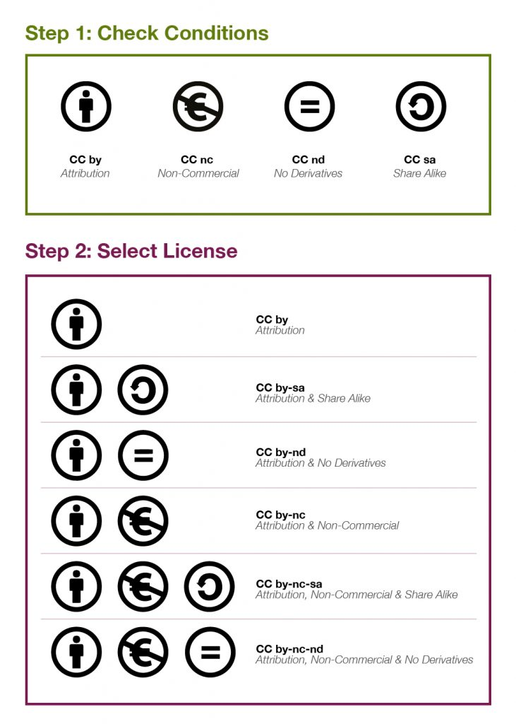
Other Considerations: copyright
Dealing with copyrighted materials
Request permission
Member checking/final approval
Publishing works (research, education, commercial, social media, etc.)
Other considerations:
Ownership and sharing
Privacy and confidentiality (animation?)

Slide 15
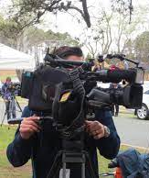
discussion
What motivates you to work on the videographic research?
What challenges did you face while doing videographic research before and during the COVID-19 pandemic?
How can we better capture consumer experiences/behaviours or consumer-marketer interactions through videography in the post-pandemic world?

Slide 16
conclusion
Videography is powerful and cutting-edge, but is also double-edged (Kozinets and Belk, 2006, p. 342)
Present “reality” versus present “truth”
Manipulate audiences through imagery, emotional appeals, music, and other editorial techniques
Participatory and experimental possibilities
Lengthy production and ethics review procedures
Challenges in theorizing videographic research

Slide 17
Thank you!
Presenter: Dr. Eric Li: eric.li@ubc.ca

Slide 18
references
Belk, R. W., Caldwell, M., Devinney, T. M., Eckhardt, G. M., Henry, P., Kozinets, R., & Plakoyiannaki, E. (2018). Envisioning consumers: How videography can contribute to marketing knowledge. Journal of Marketing Management, 34(5-6), 432-458.
Bordwell, D., & Thompson, K. (2001). Film art: An introduction (6th ed.). McGraw Hill.
Corrigan, T. (2001). A short guide to writing about film (4th ed.). Longman.
Cubitt, S. (1991). Timeshift: On video culture. Routledge.
Grierson, J. (1933). Documentary producer. Cinema Quarterly, 2(1): 7–9.
Hietanen, J., Rokka, J., Schouten, J. W. (2014). Commentary on Schembri and Boyle (2013): From representation towards expression in videographic consumer research. Journal of Business Research, 67(9), 2019-2022.
Kozinets, R. V. & Belk, R. (2006). Camcorder Society: Quality videography in consumer and marketing research. In Russell W. Belk (ed.), Handbook of Qualitative Methods in Marketing (pp. 335-339). Cheltenham: Edward Elgar.
Kuhn, A., & Westwell, G. (2012). A dictionary of film studies. Oxford University Press.
Pramaggiore, M. & Wallis, T. (2005). Film: A critical introduction. Laurence King Publishing.

Slide 19
resources
Suggested Readings:
Belk, R. W., Caldwell, M., Devinney, T. M., Eckhardt, G. M., Henry, P., Kozinets, R., & Plakoyiannaki, E. (2018). Envisioning consumers: How videography can contribute to marketing knowledge. Journal of Marketing Management, 34(5-6), 432-458. https://doi.org/10.1080/0267257X.2017.1377754
Belk, R. W., & Kozinets, R. V. (2005). Videography in marketing and consumer research. Qualitative Market Research, 8(2), 128-141. https://doi.org/10.1108/13522750510592418
Recent ACR Film Festival Award Winners:
o Thomas Stenger (2019) won Judges’ Choice Videography award for "Spot - Conquering the Public Space - Ethnography of a Spatial Practice: Downhill Longboarding" - trailer: https://vimeo.com/366754591
o Takeshi Mitsui (2019) won Best First-Time Videography award for "Zakka: Uncategorized Culture of Uncategorized Goods, An Oral History of Uncategorized Man" - trailer: https://vimeo.com/355934258
o Michelle Renee Nelson, Yanyun (Mia) Wang, Kathy Tian, Gail Ferguson, Rachel Powell, and Candice Wray (2018) won Best Videography award for “Teaching Consumer Resistance in Jamaica: Subvertising in Action” – trailer: https://vimeo.com/291221474

